Slide 2
God Looks With Favor Upon The Man Who is Willing To Listen to Him!
1 Samuel 15:23
Ecclesiastes 12:13
Matthew 7:21
Revelation 22:14

Slide 3
TO OBEY GOD ONE MUST KNOW THE WILL OF GOD
1 John 5:3

Slide 4
FROM HEAVEN OR OF MEN?
Matthew 21:25
Colossians 3:17
Matthew 7:21
1 John 3:4

Slide 5
“The Bible Doesn’t Tell Us Not To Do It!”
A Proper Understanding of And a Proper Attitude Toward The Silence of The Scriptures is Essential if we Are to be Pleasing to God

Slide 6
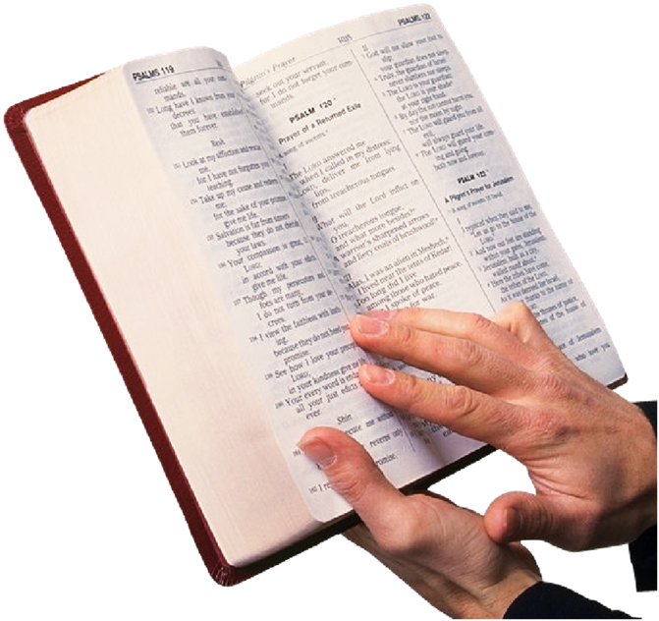
Religious Division Is Tragic!
Before unity is possible, we must have a common accepted standard of authority.

Slide 7
Most Religious Division Is Not The Result Of What The Bible Says…
But What It Does NOT SAY!

Slide 8
Practices On The Basis of “Bible Doesn’t Forbid It”
Few have problem with “baptism” being immersion
Most agree “Christian” is acceptable
Right to refer to church as being “of Christ”
No question it is acceptable to eat the Lord’s Supper each first day of the week

Slide 9
Most do Not Think Such Practices are Necessary, But Would Not Say They Are Wrong Either!
Justification for different religious practices based on idea that the “Bible doesn’t tell us NOT to do the other”

Slide 10
Question Of Proper Attitude Toward “Silence” Of The Scriptures
Luther & Zwingli – 16th Century
Luther- wanted to retain everything not specifically prohibited by Scriptures – “matters of indifference”
Zwingli – only the “authorized” should be accepted

Slide 11
“Restoration Movement” An Effort To Bring Unity To Divided Religious World – 19th Century
Division result of “creeds”
Many practices justified by “silence of Scriptures”
“Speak where the Bible speaks; be silent where the Bible is silent.”

Slide 12
Biblical Principle
1 Peter 4:11 “let him speak as the oracles of God…”
1 Corinthians 4:6 “that you may learn in us not to think beyond what is written”

Slide 13
“Silent Where Silent?”
"Require nothing more for fellowship than required in N.T.; nothing more or nothing less. If it is not authorized by command, apostolic example, or necessary inference, it is to be considered as unlawful, sinful."

Slide 14
“If God is Silent, and Doesn’t Specifically Condemn, We Must be Silent – Not Condemn”
Is The Principle Concerning The Silence Of The Scriptures a “Tradition of Man” or a Biblical Principle?
Hebrews 7:11-14
Christ cannot be priest on earth - priest & king at same time
1 Chronicles 15:2-15

Slide 15
When God Specifies What He Wants, All Other “Specifics” Are Excluded
Noah – “gopher wood” Genesis 6
Ashes of a “red heifer” Hebrews 9:13
Singing as kind of music – Ephesians 5:19
Silence Is NOT Consent!

Slide 16
What IS The “Silence” Which Is Not To Be A “Test Of Fellowship?”
Generic Authority
Wood Specified to build the Ark- not particular trees
“Red Heifer” specified, particular heifer not specified
Kind of Music Specified – details not
Cup Specified (fruit of vine)- containers not
Baptism specified – where is not
Preach, Teach gospel specified – method is not

Slide 17
SILENCE OF THE SCRIPTURES
When God Specifies His Will, We Must Not Accept Anything More OR Less
Where God Has Not Specified – Neither Should We
We Are At Liberty To Ascertain The Best Way To Do It

Slide 18
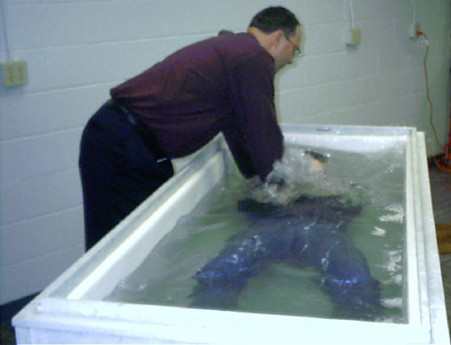
God Has Specified What To Do In Order To Become His Child
Hear – Acts 15:7
Believe – Hebrews 11:6
Repent – Acts 17:30
Confess – Romans 10:9
Baptized For Remission of Sins – Acts 2:38

